Slide 1
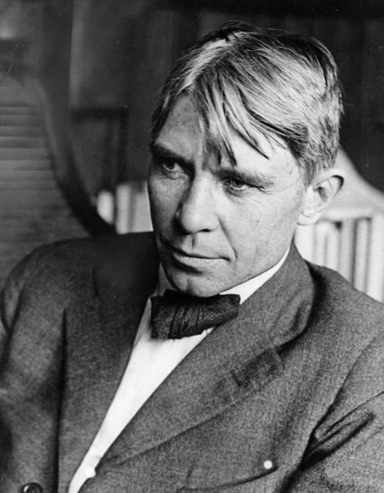
"Poet of the People“
Carl Sandburg provided a popular voice for the American people of the twentieth century and still speaks to us through his words, activism, music and the beauty and serenity of Carl Sandburg Home National Historic Site.
www.nps.gov/carl

Slide 2
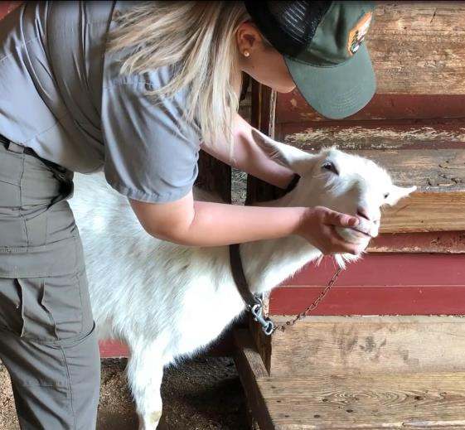
Goats at Connemara Farms
Grades K-2nd
Tasks
Click this link https://go.usa.gov/xf2vB to watch a video about “Goat Care at Connemara Farms”. Think about all the things a ranger has to do to take care of the goats.
Next, click this link https://go.usa.gov/xfT7U to read the story “Mrs. Sandburg Had a Farm.”
Look at the example of a “Five Senses Poem” on slide 3.
Think about the goats and write your own “Five Senses Poem” on the rest of the slides.
Write an opinion piece about whether you would want to take care of a goat on the last slide.
Submit to your teacher.
The purpose of this lesson is to show you how park rangers take care of the goats at Connemara Farms today, and to understand why Mrs. Sandburg had a herd of dairy goats. You will be writing about the goats using details from the video and slides.

Slide 3

Example Five Senses Poem
Sunflowers are golden yellow.
They look like gleaming rays of light.
They smell like a warm summer day.
They sound like a quiet whisper.
They feel like soft silk.
They taste like melted butter.
Sunflowers make me feel happy.

Slide 4
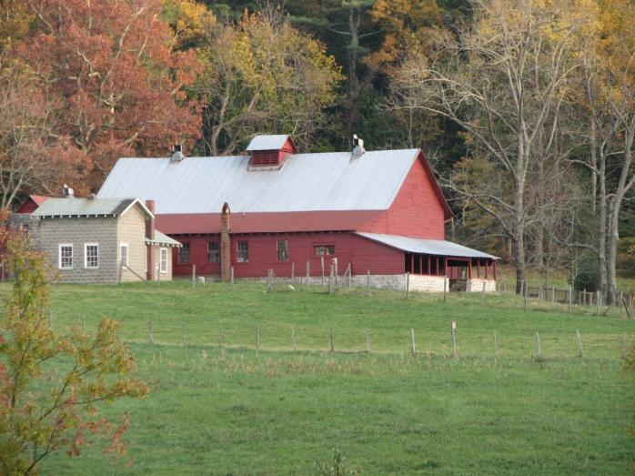
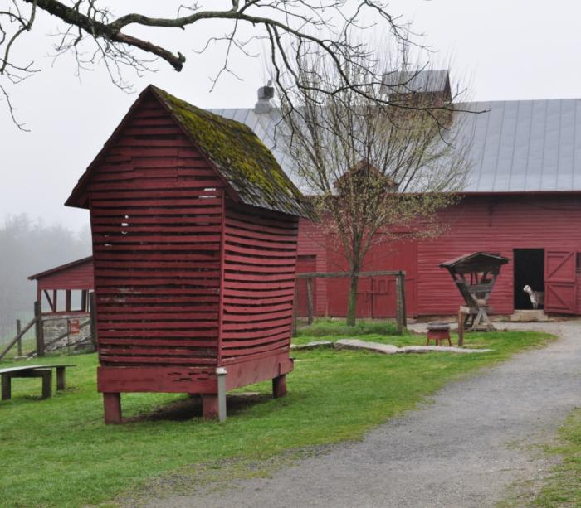
Five Senses Poem
By

Slide 5
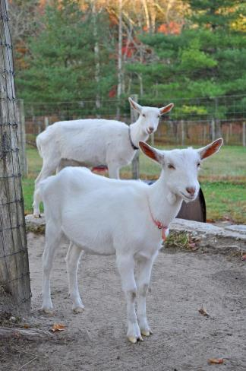
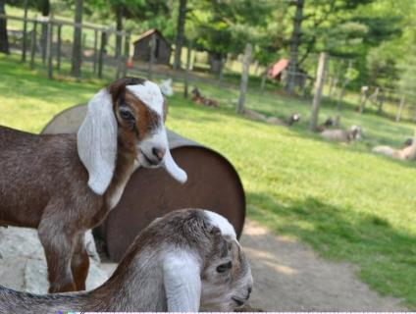
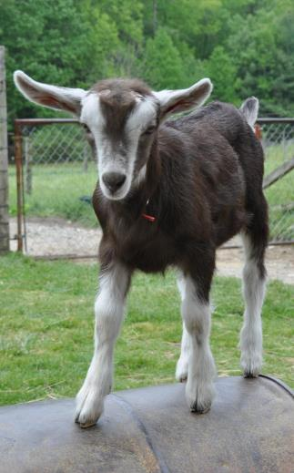
Line 1: Goats are…

Slide 6
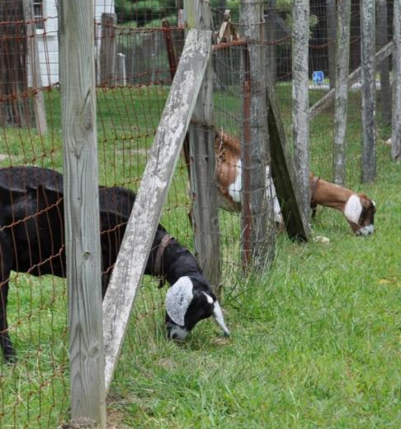
Line 2: They look like…
Line 3: They smell like…

Slide 7
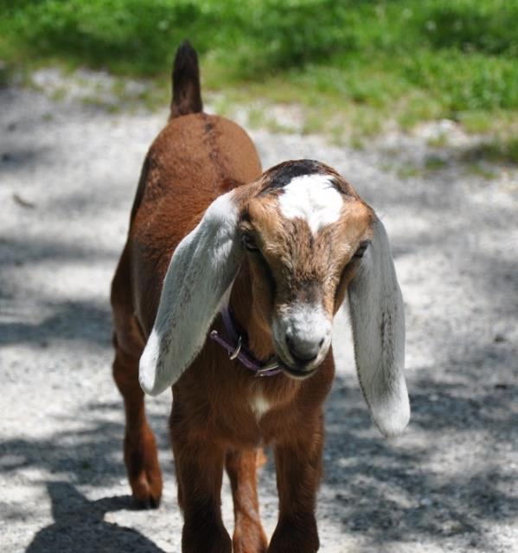
Line 4: They sound like…
Line 5: They feel like…

Slide 8
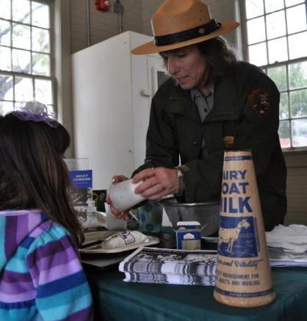
Line 6: They taste like…
Line 7: Goats are…

Slide 9
Write your opinion about having a goat to take care of.
Would you like a goat? Why or why not?
Make sure you use details from the video and slides to support your opinion.
In my opinion, I

